Slide 1
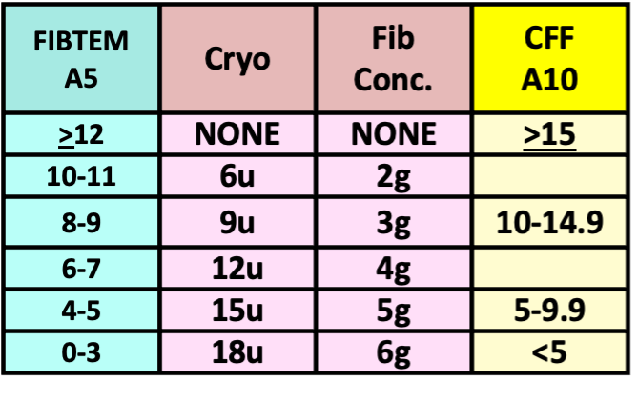
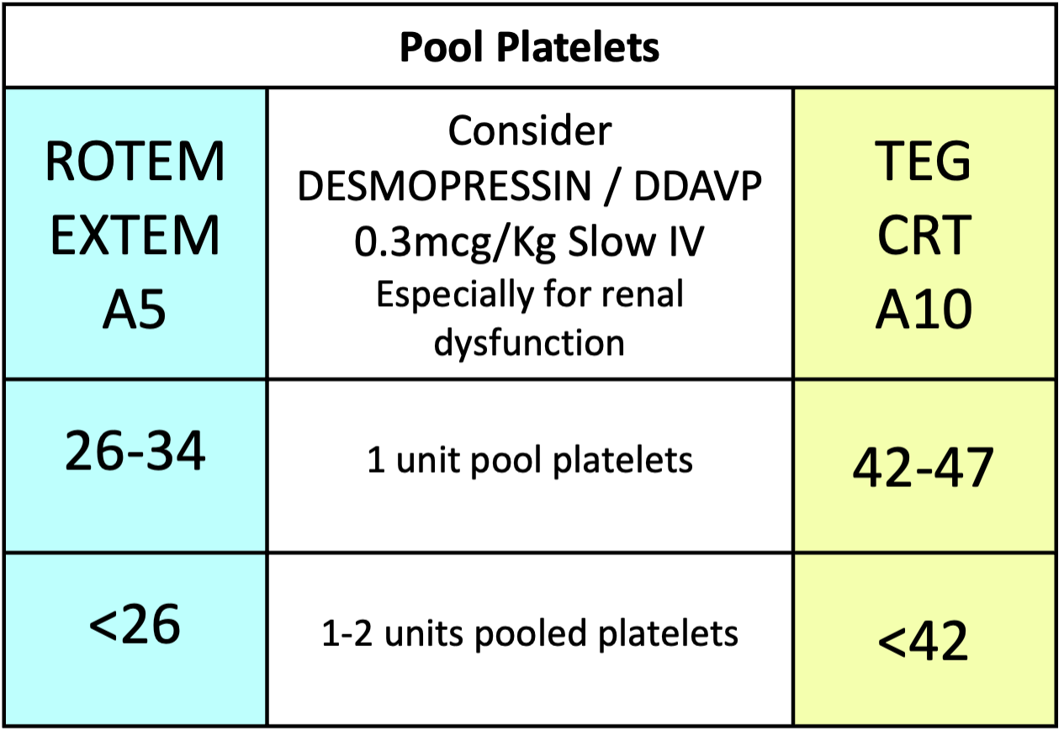
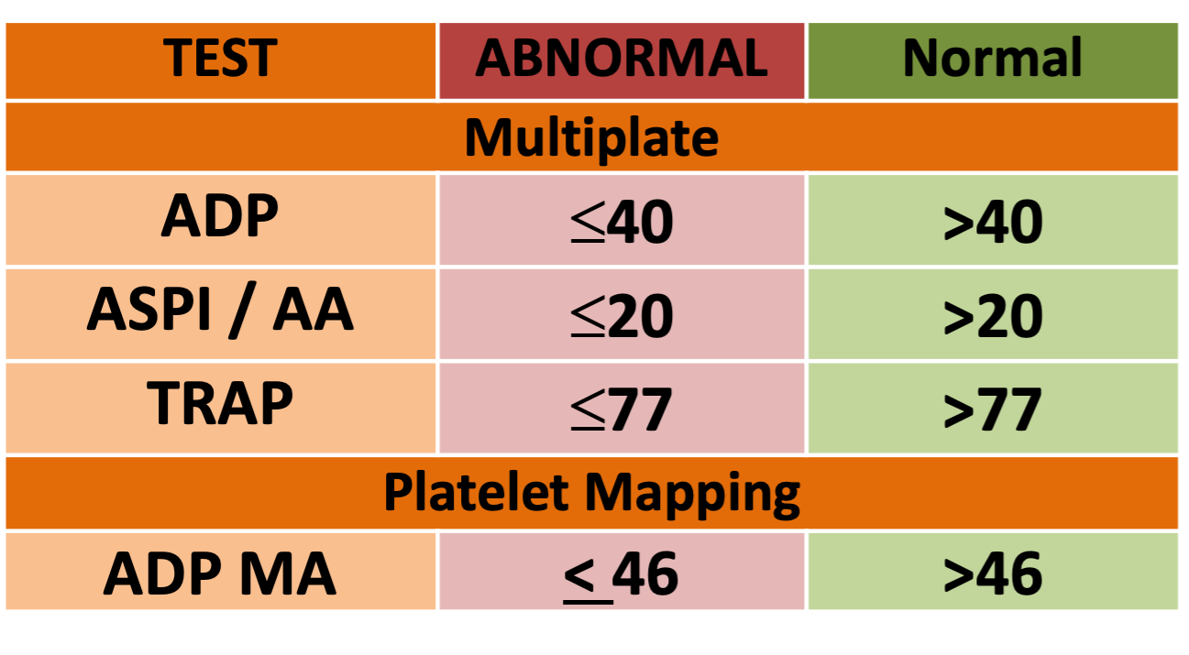
CARDIAC AND VASCULAR ROTEM & TEG GOAL DIRECTED BLEEDING MANAGEMENT ALGORITHM (2025)
Temp >36° C, pH >7.2, iCalcium >1.1 mmol/L, Platelets >70x10⁹/L, Hb >75 g/L
Adjust dose of blood products for patients <50kg after consulting senior clinician
Repeat test 10 mins
AFTER EACH INTERVENTION
IF BLEEDING CONTINUES
IS THERE CLINICALLY SIGNIFICANT BLEEDING?
YES
NO
ROTEM
Results in 10 min
Then
High risk of Fibrinolysis?
E.g. CBP, aortic dissection
Give Tranexamic Acid initial 15mg/kg then check cardiac infusion schedule
Observe
YES
Any difference is Heparin Effect
Protamine IV
0.5-1 mg/kg
RETEST
INTEM CT | Ratio >1.25? | CKR
HEPTEM CT |  | CKH-R
NO
RETEST
HEPARIN
ARE INTEM & HEPTEM CT both >205 sec? | Are CKR and CKH-R both prolonged?
YES
Possible excess protamine affecting factor V
(or intrinsic factor deficiency or factor Xa inhibitor)
Wait >10min then re-test
If prolonged after re-test, consider coagulation factor deficiency. Consider mixing studies
IF SEVERE BLEEEDING, PROCEED WITH ALGORITHM
NO
Cryo or FibConc.
If FIBTEM A5< 6 or CFF A10 <10,
ensure platelets are also available
IS FIBTEM A5 < 12mm? (close correlation to Clauss fibrinogen) | Is CFF A10 < 15mm? (Local validation recommended)
Including flat line at 5 minutes
YES
Low Fibrinogen
RETEST
FIBRINOGEN
Clinician discretion for Fibrinogen Concentrate
Usually single dose
For severely low FIBTEM or CFF
NO
PLATELETS
NORMAL FIBTEM A5 ≥ 12mm AND IS EXTEM A5 < 35mm? | NORMAL CFF A10 > 15mm AND IS CRT A10 < 47mm?
Or abnormal Multiplate/ Platelet mapping Platelet mapping assess platelet function, not contribution to clot strength
YES
Poor Platelet Contribution
RETEST
NO
FACTORS
NORMAL FIBTEM A5 ≥ 12mm AND IS EXTEM CT > 85 sec? | NORMAL CFF A10 > 15mm? AND Is CKH-R > 10 minutes
Ensure core temp >36°C and Fibrinogen corrected first
YES
Low Coagulation Factors or Oral anticoagulants (Warfarin or DOACs)
ELP/ FFP 2-4 units
OR
Beriplex
(If volume overloaded)
10-15 Units/kg IV
RETEST
NO
CLOT INSTABILITY after 30 minutes
IS FIBTEM ML ≥ 10 %? | Is CRT (LY30) > 2.2%
Clot should be stable for 1 hour, not tapering away
Hyperfibrinolysis
Consider Additional
Tranexamic Acid
Adjust subsequent dose for renal dysfunction and long bypass time
Max dose 80mg/kg per case
RETEST
FIBRINOLYSIS
YES
NO
STILL BLEEDING? Consider SURGICAL PROBLEM and discuss with surgeon and blood bank/haematologist
Make a stronger clot? Give Cryo to FIBTEM A5 > 14mm Give platelets to EXTEM A5 > 40 mm or consider Platelet Function testing (in hours) Consider ELP to shorten clotting time to EXTEM CT < 80 sec | Re check temperature, pH, iCalcium, platelets and haemoglobin Consider other contributors to bleeding Platelet inhibitors (do Multiplate Platelet Function test) Consider Von Willebrand's Disease, warfarin (INR), enoxaparin etc.
NORMAL
When clinically possible always complete the algorithm in a stepwise manner and check the ROTEM between steps as indicated. This reduces unnecessary transfusion, especially of Platelets, ELP and Beriplex

